Slide 1
My first personal web page
STUDENT NAME: RITHIKA.V
REGISTER NO AND MNID:DB9A9216BDE98FB88A944EAC57D05B87 DEPARTMENT : COMPUTER SCIENCE
COLLEGE : UNIVERSITY OF MADRAS

Slide 2
PROJECT TITLE
Digital Portfolio Web Page Front-End Development

Slide 3
AGENDA
Problem Statement Project Overview End Users Tools and Technologies Portfolio Design and Layout Features and Functionality Results and Screenshots Conclusion

Slide 4

PROBLEM STATEMENT
In today’s digital era, having a simple and interactive portfolio is essential to showcase skills and projects online. Many students struggle to design interactive web pages due to lack of technical knowledge. This project solves that by providing an easy and functional digital portfolio template.

Slide 5

PROJECT OVERVIEW
This project is a simple Digital Portfolio Web Page created using: HTML → Web structure CSS → Styling & layout JavaScript → Simple interactivity (contact form confirmation) The page includes About Me, Skills, Projects, and Contact Me sections.

Slide 6

END USERS
Students and beginners in web development Anyone who wants to create a digital portfolio easily People wanting to display their projects online Recruiters who want to see simple interactive portfolios

Slide 7
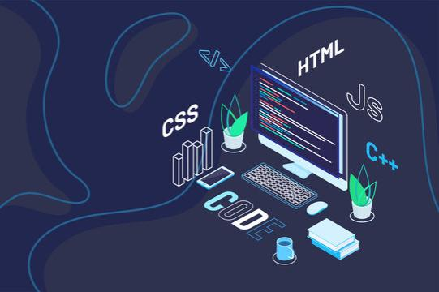
TOOLS TECHNOLOGY’S
Visual Studio Code (or any text editor) Google Chrome (for previewing) HTML, CSS, JavaScript GitHub (for code hosting)

Slide 8

PORTFOLIO DESIGN AND LAYOUT
Simple clean layout Header with name and role Sections: About Me, Skills, Projects, Contact Me Responsive and easy navigation

Slide 9
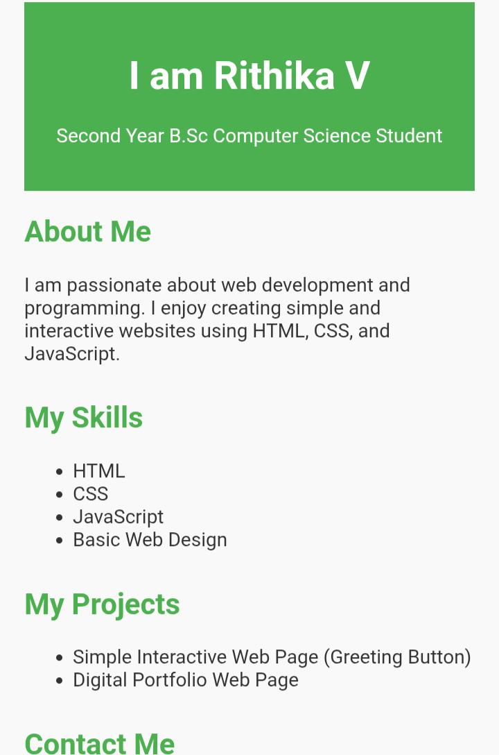
RESULT SCREENSHOT

Slide 10
FEATURES AND FUNCTIONALITY
Static content for About Me, Skills, Projects Interactive Contact Me form with JavaScript confirmation message Easy to edit and customize Simple design suitable for beginners

Slide 11
CONCLUSION
This Digital Portfolio Web Page project demonstrates a basic, easy-to-build online portfolio. It is useful for beginners who want to showcase their skills in a simple and functional way. It solves the problem of not having an interactive portfolio and is easy to extend.

Slide 12

I appreciate your time and interest in my project.

